Slide 1

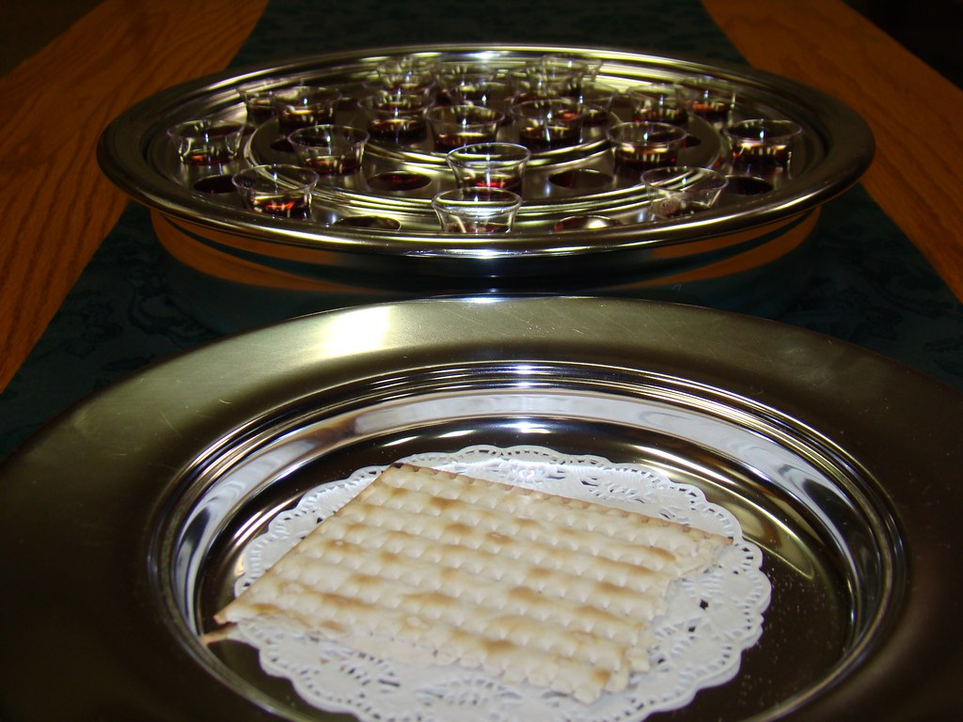
Understanding Communion
Theo
This Photo by Unknown Author is licensed under CC BY-NC

Slide 2




Agenda
What is Communion?
Understanding Passover and its storyline
Jesus’ last Supper and its storyline
How they relate to each other?
A brief look at Temple Sacrifice

Slide 3
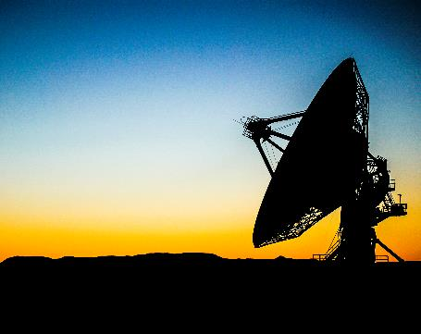


Introduction
Psalms 105:3-4 NASB
Glory in His holy name;
Let the heart of those who seek the LORD be glad.
Seek the LORD and His strength;
Seek His face continually.
continually
Notes:
As Christians, we don’t stop seeking God even after you are baptised.

Slide 4
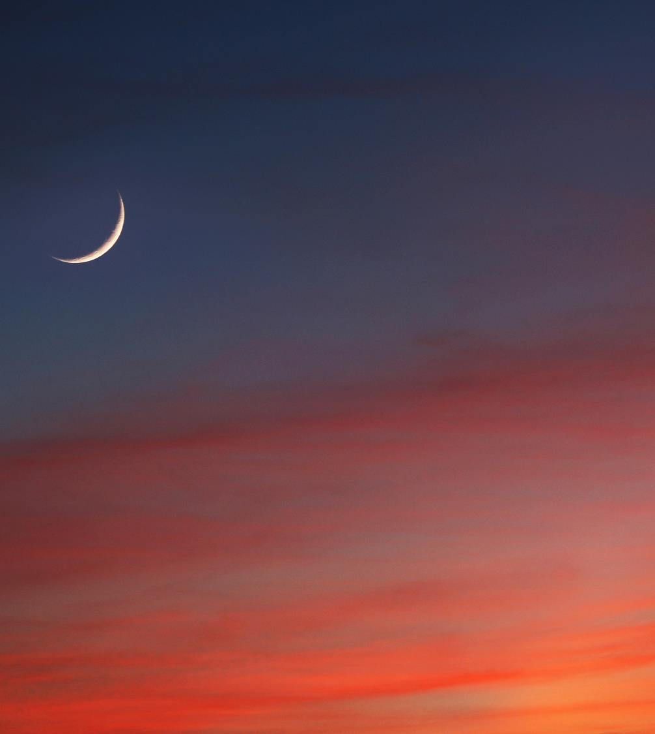
What is communion
κλάσις klasis 1) a breaking | ἄρτος artos 1) food composed of flour mixed with water and baked 1a) the Israelites made it in the form of an oblong or round cake, as thick as one’s thumb, and as large as a plate or platter hence it was not to be cut but broken 1b) loaves were consecrated to the Lord 1c) of the bread used at the love-feasts and at the Lord’s Table 2) food of any kind
Breaking Bread
Acts 2:42, 2:46, 20:7
Luke 22:19
κυριακός kuriakos 1) belonging to the Lord 2) related to the Lord | δεῖπνον deipnon 1) supper, especially a formal meal usually held at the evening 1a) used of the Messiah’s feast, symbolising salvation in the kingdom 2) food taken at evening
κυριακός kuriakos 1) belonging to the Lord 2) related to the Lord | δεῖπνον deipnon 1) supper, especially a formal meal usually held at the evening 1a) used of the Messiah’s feast, symbolising salvation in the kingdom 2) food taken at evening
Lord’s Supper
1 Corinthians 11:20
implied
1 Corinthians 11:23-25
Matthew 26:26-28
Mark 14:22-24
Luke 22:19-20
ἀγάπη agapē 1) brotherly love, affection, good will, love, benevolence 2) love feasts | συνευωχέω suneuōcheō 1) to entertain together 2) to feast sumptuously with
Love Feast
Jude 1:12
similar 2 Peter 2:13
κοινωνία koinōnia 1) fellowship, association, community, communion, joint participation, intercourse 1a) the share which one has in anything, participation 1b) intercourse, fellowship, intimacy 1b1) the right hand as a sign and pledge of fellowship (in fulfilling the apostolic office) 1c) a gift jointly contributed, a collection, a contribution, as exhibiting an embodiment and proof of fellowship
Communion
1 Corinthians 10:16-17
Acts 2:42 day by day
Communion
1 Corinthians 10:16-17
Acts 2:42 day by day
Notes:
Communion is described as a supper. Supper means evening meal. It is not imperative to break bread in the evenings or daily. This is to show you that it is what they did in the beginning.

Slide 5
Before Passover aka Pesach (Cleanse)
John 13:10 Jesus *said to him, "He who has bathed needs only to wash his feet, but is completely clean; and you are clean, but not all of you.“
John 15:1-10 "I am the true vine, and My Father is the vinedresser. "Every branch in Me that does not bear fruit, He takes away; and every branch that bears fruit, He prunes it so that it may bear more fruit. "You are already clean because of the word which I have spoken to you. "Abide in Me, and I in you. As the branch cannot bear fruit of itself unless it abides in the vine, so neither can you unless you abide in Me. "I am the vine, you are the branches; he who abides in Me and I in him, he bears much fruit, for apart from Me you can do nothing. "If anyone does not abide in Me, he is thrown away as a branch and dries up; and they gather them, and cast them into the fire and they are burned. "If you abide in Me, and My words abide in you, ask whatever you wish, and it will be done for you. "My Father is glorified by this, that you bear much fruit, and so prove to be My disciples. "Just as the Father has loved Me, I have also loved you; abide in My love. "If you keep My commandments, you will abide in My love; just as I have kept My Father's commandments and abide in His love.
Nisan 13 and before
Exodus 12:15,19
Title
Title
Deuteronomy 16:4
Removal of leaven
Title
Title
Matthew 16:6,12 Luke 12:1 1 Corinthians 5
Before last supper
John 13:1-20, 15:1-10
Matthew 26:21-25; Mark 14:18-21;
Luke 22:21-23; John 13:21-30
Washing of feet
Predicts betrayal
Title
Title
Title
Title
Exodus 12:15 Seven days you shall eat unleavened bread. On the first day you shall remove leaven out of your houses, for if anyone eats what is leavened from the first day until the seventh day, that person shall be cut off from Israel.
Matthew 16:6,12 And Jesus said to them, "Watch out and beware of the leaven of the Pharisees and Sadducees.“ Then they understood that He did not say to beware of the leaven of bread, but of the teaching of the Pharisees and Sadducees.
Luke 12:1 Under these circumstances, after so many thousands of people had gathered together that they were stepping on one another, He began saying to His disciples first of all, "Beware of the leaven of the Pharisees, which is hypocrisy.
1Co 5:6-13 Your boasting is not good. Do you not know that a little leaven leavens the whole lump of dough? Clean out the old leaven so that you may be a new lump, just as you are in fact unleavened. For Christ our Passover also has been sacrificed. Therefore let us celebrate the feast, not with old leaven, nor with the leaven of malice and wickedness, but with the unleavened bread of sincerity and truth. I wrote you in my letter not to associate with immoral people; I did not at all mean with the immoral people of this world, or with the covetous and swindlers, or with idolaters, for then you would have to go out of the world. But actually, I wrote to you not to associate with any so-called brother if he is an immoral person, or covetous, or an idolater, or a reviler, or a drunkard, or a swindler—not even to eat with such a one. For what have I to do with judging outsiders? Do you not judge those who are within the church? But those who are outside, God judges. REMOVE THE WICKED MAN FROM AMONG YOURSELVES.
Notes:
Nisan is the first month in the Jewish Calendar
Malice and Wickedness vs Sincerity and Truth:
These are the environment of which we (the bread) are in. In other words, we should be transparent and not be malicious to each other. The list of sins are serious and parallel the leaven in Passover in the sense that you are to expel the wicked man if you find they are doing such things regularly.
Jesus also emphasizes that to be clean, you have accepted and kept his commandments.
All these “actions” were done prior to the actual ritual: Passover and the Last Supper.

Slide 6
The Leavened of Matthew 16 and Luke 12
Ψευδοδιδάσκαλος (false teacher)
pseudodidaskalos
1) a false teacher
̔ποκριτής (hypocrite)
hupokritēs
1) one who answers, an interpreter
2) an actor, stage player
3) a dissembler, pretender, hypocrite
Galatians 5:6-11 For in Christ Jesus neither circumcision nor uncircumcision means anything, but faith working through love. You were running well; who hindered you from obeying the truth? This persuasion did not come from Him who calls you. A little leaven leavens the whole lump of dough. I have confidence in you in the Lord that you will adopt no other view; but the one who is disturbing you will bear his judgment, whoever he is. But I, brethren, if I still preach circumcision, why am I still persecuted? Then the stumbling block of the cross has been abolished.
Leaven (noun, verb) - Merriam-Webster:
Noun:
A substance (such as yeast) used to produce fermentation in dough, causing it to rise.
Matthew 15:1-9 Then some Pharisees and scribes *came to Jesus from Jerusalem and said, "Why do Your disciples break the tradition of the elders? For they do not wash their hands when they eat bread.“ And He answered and said to them, "Why do you yourselves transgress the commandment of God for the sake of your tradition? "For God said, 'HONOR YOUR FATHER AND MOTHER,' and, 'HE WHO SPEAKS EVIL OF FATHER OR MOTHER IS TO BE PUT TO DEATH.' "But you say, 'Whoever says to his father or mother, "Whatever I have that would help you has been given to God," he is not to honor his father or his mother.' And by this you invalidated the word of God for the sake of your tradition. "You hypocrites, rightly did Isaiah prophesy of you: 'THIS PEOPLE HONORS ME WITH THEIR LIPS, BUT THEIR HEART IS FAR AWAY FROM ME. 'BUT IN VAIN DO THEY WORSHIP ME, TEACHING AS DOCTRINES THE PRECEPTS OF MEN.'"
Matthew 15:1-9 Then some Pharisees and scribes *came to Jesus from Jerusalem and said, "Why do Your disciples break the tradition of the elders? For they do not wash their hands when they eat bread.“ And He answered and said to them, "Why do you yourselves transgress the commandment of God for the sake of your tradition? "For God said, 'HONOR YOUR FATHER AND MOTHER,' and, 'HE WHO SPEAKS EVIL OF FATHER OR MOTHER IS TO BE PUT TO DEATH.' "But you say, 'Whoever says to his father or mother, "Whatever I have that would help you has been given to God," he is not to honor his father or his mother.' And by this you invalidated the word of God for the sake of your tradition. "You hypocrites, rightly did Isaiah prophesy of you: 'THIS PEOPLE HONORS ME WITH THEIR LIPS, BUT THEIR HEART IS FAR AWAY FROM ME. 'BUT IN VAIN DO THEY WORSHIP ME, TEACHING AS DOCTRINES THE PRECEPTS OF MEN.'"
Notes:
First slide on leaven, we look at Jesus’ teachings on leaven.
These are further verses that explain Matt 16 and Luke 12.
Paul has enforced this after Jesus’ teaching by stating that false teachers persuade believers using words that don’t come from God/Jesus.
Matt 15:1-9 explains the leaven prior to Matt 16 by stating the Pharisees are hypocrites and follow manmade teachings, a characteristic of false teachers.
We have a definition of leaven here for those who don’t know what yeast is.

Slide 7
What could be a false teaching or bad interpretation?
Matthew 13:33 He spoke another parable to them, "The kingdom of heaven is like leaven, which a woman took and hid in three pecks of flour until it was all leavened."
Ephesians 2:19-22 So then you are no longer strangers and aliens, but you are fellow citizens with the saints, and are of God's household, having been built on the foundation of the apostles and prophets, Christ Jesus Himself being the corner stone, in whom the whole building, being fitted together, is growing into a holy temple in the Lord, in whom you also are being built together into a dwelling of God in the Spirit.
1. Origen (c. 184–253) "The leaven is the doctrine of Christ, hidden in the three measures, which are the whole of mankind, until the whole is filled with the knowledge of God."
2. Hilary of Poitiers (c. 310–367) "The Lord compared the kingdom of heaven with leaven, because the power of the kingdom, though hidden and small, would spread through the whole mass of humanity, which he signified by the three measures, namely, the sons of Noah."
3. John Chrysostom (c. 347–407) "For as the leaven, being mixed with the flour, changes the whole into its own nature, so too the word of God, coming into us, transforms all things… It does not show itself openly, but works in a hidden way."
4. Jerome (c. 347–420) "The woman is the Church, the leaven is the Gospel of the kingdom, and the three measures of meal are the human race, into which the doctrine of Christ is infused until all are leavened."
5. Augustine of Hippo (354–430) "The leaven is the love of God and the grace of the Holy Spirit, which a woman, that is, the Church, hides in three measures of meal, that is, in the heart, soul, and mind… until the whole is leavened with divine charity."
6. Bede the Venerable (c. 673–735) leaven as "the doctrine of Christ, which, though small in its beginnings, spreads through the whole lump of the human race, represented by the three measures, signifying the work of the Father, Son, and Holy Spirit."
7. Theophylact of Ohrid (c. 1050–1107) "The leaven is the preaching of the apostles, and the three measures of meal are the nations of the world, or the three parts of man—body, soul, and spirit—into which the kingdom’s power is mixed until all are transformed."
8. Thomas Aquinas (1225–1274) "The leaven signifies the word of God or His grace, which the woman, that is, the Church, hides in three measures of meal, that is, either the three parts of the world or the three faculties of man, until the whole is leavened."
9. John Calvin (1509–1564) "The leaven denotes the progress of the Gospel, which, though it seems contemptible at first, spreads far and wide… Christ here uses leaven not in its usual sense of corruption, but as an emblem of growth."
10. John Gill (1697–1771) "The leaven may be interpreted either of the Gospel, which… gradually increases until it diffuses itself through nations; or, as leaven is elsewhere used, of corrupt doctrine, though here it seems to intend the Gospel’s secret working."
11. Matthew Henry (1662–1714) "The leaven is the Gospel, the woman the ministers of it or the Church, the three measures the world or the hearts of men; it works silently and insensibly, yet strongly and irresistibly, till all be leavened."
12. Charles Spurgeon (1834–1892) "The kingdom is like leaven—small, hidden, but mighty in its working; it will not cease until the whole world feels its power."
13. David Guzik (Contemporary) "Jesus used leaven to picture something that starts small but spreads… Though leaven often symbolizes evil in Scripture, here it likely represents the hidden growth of God’s kingdom."
14. John MacArthur (Contemporary) "Leaven in Scripture consistently represents evil… The parable suggests corruption entering the kingdom—a woman, often a symbol of evil influence, hides leaven in the meal, picturing false teaching spreading through the church.“ ?
15. N.T. Wright (1948–Present) "The kingdom is like leaven—ordinary, hidden, surprising… It’s about God’s new life breaking into the world in unexpected ways, not with fanfare but with quiet power."
1. Origen (c. 184–253) "The leaven is the doctrine of Christ, hidden in the three measures, which are the whole of mankind, until the whole is filled with the knowledge of God."
2. Hilary of Poitiers (c. 310–367) "The Lord compared the kingdom of heaven with leaven, because the power of the kingdom, though hidden and small, would spread through the whole mass of humanity, which he signified by the three measures, namely, the sons of Noah."
3. John Chrysostom (c. 347–407) "For as the leaven, being mixed with the flour, changes the whole into its own nature, so too the word of God, coming into us, transforms all things… It does not show itself openly, but works in a hidden way."
4. Jerome (c. 347–420) "The woman is the Church, the leaven is the Gospel of the kingdom, and the three measures of meal are the human race, into which the doctrine of Christ is infused until all are leavened."
5. Augustine of Hippo (354–430) "The leaven is the love of God and the grace of the Holy Spirit, which a woman, that is, the Church, hides in three measures of meal, that is, in the heart, soul, and mind… until the whole is leavened with divine charity."
6. Bede the Venerable (c. 673–735) leaven as "the doctrine of Christ, which, though small in its beginnings, spreads through the whole lump of the human race, represented by the three measures, signifying the work of the Father, Son, and Holy Spirit."
7. Theophylact of Ohrid (c. 1050–1107) "The leaven is the preaching of the apostles, and the three measures of meal are the nations of the world, or the three parts of man—body, soul, and spirit—into which the kingdom’s power is mixed until all are transformed."
8. Thomas Aquinas (1225–1274) "The leaven signifies the word of God or His grace, which the woman, that is, the Church, hides in three measures of meal, that is, either the three parts of the world or the three faculties of man, until the whole is leavened."
9. John Calvin (1509–1564) "The leaven denotes the progress of the Gospel, which, though it seems contemptible at first, spreads far and wide… Christ here uses leaven not in its usual sense of corruption, but as an emblem of growth."
10. John Gill (1697–1771) "The leaven may be interpreted either of the Gospel, which… gradually increases until it diffuses itself through nations; or, as leaven is elsewhere used, of corrupt doctrine, though here it seems to intend the Gospel’s secret working."
11. Matthew Henry (1662–1714) "The leaven is the Gospel, the woman the ministers of it or the Church, the three measures the world or the hearts of men; it works silently and insensibly, yet strongly and irresistibly, till all be leavened."
12. Charles Spurgeon (1834–1892) "The kingdom is like leaven—small, hidden, but mighty in its working; it will not cease until the whole world feels its power."
13. David Guzik (Contemporary) "Jesus used leaven to picture something that starts small but spreads… Though leaven often symbolizes evil in Scripture, here it likely represents the hidden growth of God’s kingdom."
14. John MacArthur (Contemporary) "Leaven in Scripture consistently represents evil… The parable suggests corruption entering the kingdom—a woman, often a symbol of evil influence, hides leaven in the meal, picturing false teaching spreading through the church."
15. N.T. Wright (1948–Present) "The kingdom is like leaven—ordinary, hidden, surprising… It’s about God’s new life breaking into the world in unexpected ways, not with fanfare but with quiet power."
Matthew 7:24-27 "Therefore everyone who hears these words of Mine and acts on them, may be compared to a wise man who built his house on the rock. "And the rain fell, and the floods came, and the winds blew and slammed against that house; and yet it did not fall, for it had been founded on the rock. "Everyone who hears these words of Mine and does not act on them, will be like a foolish man who built his house on the sand. "The rain fell, and the floods came, and the winds blew and slammed against that house; and it fell—and great was its fall."
Foundation
1 Corinthians 3:9-11
1 Peter 2:5-8 you also, as living stones, are being built up as a spiritual house for a holy priesthood, to offer up spiritual sacrifices acceptable to God through Jesus Christ. For this is contained in Scripture: "BEHOLD, I LAY IN ZION A CHOICE STONE, A PRECIOUS CORNER stone, AND HE WHO BELIEVES IN HIM WILL NOT BE DISAPPOINTED." This precious value, then, is for you who believe; but for those who disbelieve, "THE STONE WHICH THE BUILDERS REJECTED, THIS BECAME THE VERY CORNER stone," and, "A STONE OF STUMBLING AND A ROCK OF OFFENSE"; for they stumble because they are disobedient to the word, and to this doom they were also appointed.
Cornerstone
Paul the Apostle (c. 5-67) "A little leaven leavens the whole lump,“ Gal 5:9, 1 Corinthians 5:6
Notes:
This shows how church fathers and Bible commentators have interpreted Matthew 13:33 over the years.
Some have acknowledged Paul while others became “creative” in their thinking.
Its good to ask who is right?
Then show Paul’s teaching… and ask who would you rather follow?
Next you show Ephesians because this is likely what the Bible was meant to be written and followed. Probably compiled.
The teachings of Jesus, Apostles and Prophets: there is no-one else you should really be following.
Of note: the list of misinterpretations have big names:
Martin Luther (translated Bible from Latin to readable German), John Calvin (well known Protestant), Matthew Henry (famous commentator), John Gill (very good commentator who provides great background to texts)
Emphasize that your faith should be based on Cornerstone and Foundational teachings of Jesus, Apostles and Prophets… All other stories are examples…
Paul stated in 1 Cor 3 that he is a master builder laying down foundations
Finale: Combine all the building statements Jesus’ sand/rock building, Paul’s household building and Peter’s building of holy stones…
Your faith should be built on rock to withstand the rains/floods, it should be based on Jesus, Apostles and Prophets trachings. Those who were disobedient stumble since they got creative or have their own ideas (man-made) etc
There are many teachings of Jesus that can paraphrased by Apostles or Prophets.
BONUS: Many of the church fathers and commentators have interpreted leaven positively because of the mustard seed parable that tells about church growth so they assumed leaven meant to have positive church growth.
Question: What can you tell us Jesus was really saying in Matthew 13?
Hint: Its in Acts and the Epistles
Answer: He predicted the church would grow like a mustard seed to an unnaturally big tree (mustard plants become bushes). Birds perching on its branches signify Gentiles (according to Nebuchadnezzar’s dream). The church eventually becomes leavened because of corruption. This is what happened in Acts and the Epistles.

Slide 8
The Leavened of 1 Corinthians 5
πόρνος (Sexually Immoral)
pornos
1) a man who prostitutes his body to another’s lust for hire
2) a male prostitute
3) a man who indulges in unlawful sexual intercourse, a fornicator
1 Cor 6:15-20
εἰδωλολάτρης (Idolater)
eidōlolatrēs
1) a worshipper of false gods, a idolater
    1a) used of any one even Christian, participant in any way in the worship of the heathen, especially one who attends their sacrificial feasts and eats of the remains of offered victims
2) a covetous man as a worshipper of Mammon
1 Cor 10:12-22, Colossians 3:5, 1 Cor 1:10-17, Acts 28:2-6
πλεονέκτης (Covetous/Greedy)
pleonektēs
1) one eager to have more, especially what belongs to others
2) greedy of gain, covetous
Luke 12:15
λοίδορος (Reviler/Slanderer)
loidoros
1) a railer, reviler
James 3:10, Psalms 101:5-7, Matt 12:24, 2 Sam 16:5-7
someone who engages in verbal abuse, slander, or insulting language. A reviler is characterized by harsh, abusive, or reproachful speech intended to demean, humiliate, or harm others. In modern terms, this could be likened to a verbal abuser or someone who habitually uses insulting or malicious words to attack others' character or reputation.
μέθυσος (drunkard)
methusos
1) drunken, intoxicated
Colossians 3:5
ἅρπαξ (Swindler)
harpax
1) rapacious, ravenous
2) a extortioner, a robber
Luke 19:8-9
Notes:
This list of leaven is serious because Paul states to eject people like this.
Of note that we might not understand too much:
Idolator: we have 1 Cor 10 to explain that idolising something too much can incur the Lord’s jealousy. It is good to have a hobby and interest but do not love something so much to the point to neglect the Lord. We can also see that people worship people in 1 Cor 1. There are also examples in Acts
Reviler: This one is controversial. Propaganda abounds today as it did yesterday.
You will find this everywhere in today’s world:
Politics, Media, “Public Relations”, Advertising
A modern term is to do “character assassination”. Its root cause is deception, ignorance and abuse.
Swindler: This is also another controversial one. This doesn’t just cover classic swindlers.
Evident in: Politics, Science, Advertising, Medicine, Health and Nutrition
They rely on half truths, theories, white lies etc. Root cause is deception, ignorance and greed.
Keep away from people like these. Follow what 1 Cor 5 says: Socialize but don’t be like them.
Be sure to step back and investigate. Ideally do not be emotionally involved with them.

Slide 9
What are good examples of leavened/unleavened personal outcomes?
Category | Saul | David | Similar Precedent
Initial Calling | Chosen by God, anointed by Samuel (1 Samuel 10:1); Spirit empowered him (1 Samuel 10:10). Prophesied (1 Samuel 10:5-13) | Anointed by Samuel as God’s choice (1 Samuel 16:13); Spirit came upon him (1 Samuel 16:13). Prophesied (2 Samuel 23:1-2) | Both divinely selected and Spirit-filled at the start.
Early Faithfulness | Obeyed God initially, led with divine favor (1 Samuel 11:6-7). | Trusted God against Goliath, praised Him (1 Samuel 17:45-47). | Both began with reliance on God’s guidance.
Major Infractions | 1. Unauthorized sacrifice (1 Samuel 13:8-14). 2. Disobedience and Greed in Amalekite war (1 Samuel 15:1-23). 3. Murder of priests (1 Samuel 22:6-19). 4. Necromancy (1 Samuel 28:7-20). | 1. Adultery with Bathsheba (2 Samuel 11:2-5). 2. Murder of Uriah (2 Samuel 11:14-17). 3. Census out of pride (2 Samuel 24:1-10). 4. Polygamy (2 Samuel 3:2-5). | Both sinned gravely against God’s laws as leaders.
Nature of Sins | Disobedience, greed, envy-driven murder, forbidden practices. | Lust, murder, pride; personal moral failings. | Both violated God’s direct commands or moral code.
Response to Sin | Denied or justified sins, no repentance (e.g., 1 Samuel 15:20-21). | Confessed and repented (e.g., 2 Samuel 12:13, Psalm 51). | Both faced divine confrontation (Samuel/Nathan).
Divine Communication | Lost God’s favour (1 Samuel 15:11); no answers via prophets or Urim (1 Samuel 28:6). | Retained access to God through prophets (e.g., Nathan, Gad) and prayer. | Both initially heard from God, outcomes diverged.
Consequences | Rejected as king (1 Samuel 15:23); died under judgment (1 Samuel 31). | Forgiven but punished (e.g., child’s death, 2 Samuel 12:14); dynasty endured. | Both faced God’s discipline for their sins.
Relationship Outcome | Permanently severed; turned to witchcraft (1 Samuel 28). | Restored after repentance; “man after God’s heart” (Acts 13:22). | Both tested by sin, but faith repentance determined fate.
Ecclesiastes 7:8 ESV Better is the end of a thing than its beginning, and the patient in spirit is better than the proud in spirit.
It’s not how you start out, but it’s how you end that counts. George W. Truett Baptist pastor 1926
It’s not how you start, it’s how you finish. Pat Riley basketball coach 2001
Notes:
Both received the Holy Spirit
Both were humble initially
Saul became proud and disobedient.
David quickly repents once he realises his mistakes.
We should aspire to be David to be men and women after God’s heart.
BONUS: What and who might Ecclesiastes 7:8 describe?
Answer: It is Saul, who had a bad outcome. His first sin (infraction) was an unauthorized sacrifice because he was impatient and proud. He did not wait for Samuel and thought to himself to make the sacrifice without Samuel.

Slide 10
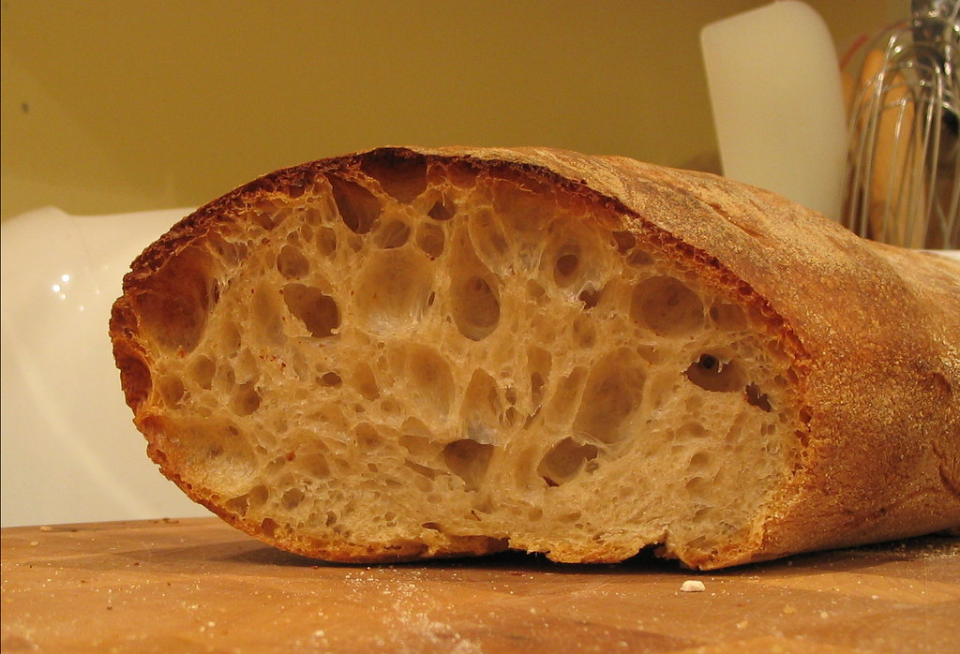
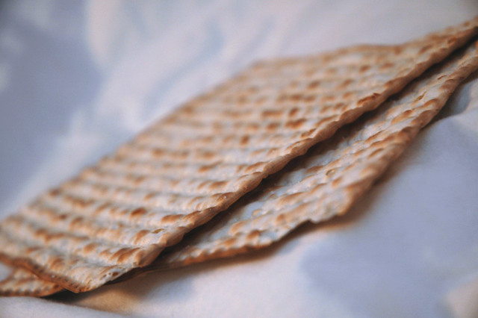
Leavened Unleavened
φυσιόω
phusioō
1) to make natural, to cause a thing to pass into nature
2) to inflate, blow up, to cause to swell up
    2a) to puff up, make proud
2b) to be puffed up, to bear one’s self loftily, be proud
1 Corinthians 4:6 (LSV) "So that in us you may learn not to think beyond what is written, that none of you may be puffed up for one against the other.“
1 Corinthians 4:18 (LSV) "And some were puffed up as if I were not coming to you.“
1 Corinthians 4:19 (LSV) "But I will come quickly to you, if the LORD may will, and I will know not the word of those puffed up, but the power.“
1 Corinthians 5:2 (LSV) "And you are puffed up, and did not rather mourn, that he may be put out of the midst of you who did this work."
1 Corinthians 8:1 (LSV) "And concerning the things sacrificed to idols, we have known that we all have knowledge: knowledge puffs up, but love builds up."
1 Corinthians 13:4 (LSV) "Love is long-suffering, it is kind, love does not envy, love does not vaunt itself, is not puffed up,"
Colossians 2:18 (LSV) "Let no one deceive you of your prize, delighting in humble-mindedness and in worship of the messengers, intruding into the things he has not seen, being vainly puffed up by the mind of his flesh,"
1 Corinthians 4:6 (NASB) "so that no one of you will become arrogant in behalf of one against the other.“
1 Corinthians 4:18 (NASB) "Now some have become arrogant, as though I were not coming to you."
1 Corinthians 4:19 (NASB) "But I will come to you soon, if the Lord wills, and I shall find out, not the words of those who are arrogant, but their power."
1 Corinthians 5:2 (NASB) "You have become arrogant and have not mourned instead."
1 Corinthians 8:1 (NASB) "Knowledge makes one arrogant, but love edifies."
1 Corinthians 13:4 (NASB) "Love… is not arrogant."
Colossians 2:18 (NASB) "Let no one keep defrauding you of your prize by delighting in self-abasement and the worship of the angels, taking his stand on visions he has seen, inflated without cause by his fleshly mind."
1 Corinthians 4:6 (NIV) "Now, brothers and sisters, I have applied these things to myself and Apollos for your benefit, so that you may learn from us the meaning of the saying, 'Do not go beyond what is written.' Then you will not be puffed up in being a follower of one of us over against the other.“
1 Corinthians 4:18 (NIV) "Some of you have become arrogant, as if I were not coming to you."
1 Corinthians 4:19 (NIV) "But I will come to you very soon, if the Lord is willing, and then I will find out not only how these arrogant people are talking, but what power they have."
1 Corinthians 5:2 (NIV) "And you are proud! Shouldn’t you rather have gone into mourning and have put out of your fellowship the man who has been doing this?"
1 Corinthians 8:1 (NIV) But knowledge puffs up while love builds up."
1 Corinthians 13:4 (NIV) "Love is patient, love is kind. It does not envy, it does not boast, it is not proud."
Colossians 2:18 (NIV) "Do not let anyone who delights in false humility and the worship of angels disqualify you. Such a person also goes into great detail about what they have seen; they are puffed up with idle notions by their unspiritual mind."
Notes:
Final slide of leaven
This is the action of leaven and what it results in puffing up of bread.
You can see that it also means to be proud.
The Literal Standard Version shows us the actual text that means to puff up.
How odd is it that the Greek language used puffing up to describe pride? Which also describes what Leaven does.
Coincidence?

Slide 11
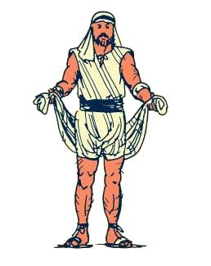
Around Passover (Being Ready)
Nisan 13 and before
Exodus 12:15,19
Deuteronomy 16:4
Removal of leaven
Nisan 14
Nisan 14
Exodus 12:6-11, 12:22, Numbers 9:12
Lambs killed and eaten
Blood on doorposts. Being Ready
Festival of Unleavened Bread
Exodus 12:12-14
Lord strikes firstborn
Passes over the “chosen”
Matthew 16:6,12 Luke 12:1, 1 Corinthians 5
1 Corinthians 10:16-18
Luke 12:35-37 LSV, 1 Peter 1:13 LSV, Ephesians 6:12-15
Hebrews 10:22, 11:28 1 Peter 1:2, Revelation 3:20, Matthew 12:43-45
Before last supper
John 13:1-20, 15:1-10
Matthew 26:21-25; Mark 14:18-21;
Luke 22:21-23; John 13:21-30
Washing of feet
Predicts betrayal
During last supper
Matthew 26:26-29, John 6:53-58
Lord’s Supper instituted
Jesus’ discourse
Jesus dies
John 13-17, Mark 14:26
Matthew 28:1, Mark 16:2
Luke 24:1, John 20:1
Jesus resurrects
John 17-19
Prayer, Betrayal, Crucifixion
Teaches: Being the Way, Love, Obedience, promises Holy Spirit, warns of persecution, Sings, Prays
Exodus 12:6-11 'You shall keep it until the fourteenth day of the same month, then the whole assembly of the congregation of Israel is to kill it at twilight. 'Moreover, they shall take some of the blood and put it on the two doorposts and on the lintel of the houses in which they eat it. 'They shall eat the flesh that same night, roasted with fire, and they shall eat it with unleavened bread and bitter herbs. 'Do not eat any of it raw or boiled at all with water, but rather roasted with fire, both its head and its legs along with its entrails. 'And you shall not leave any of it over until morning, but whatever is left of it until morning, you shall burn with fire. 'Now you shall eat it in this manner: with your loins girded, your sandals on your feet, and your staff in your hand; and you shall eat it in haste—it is the LORD'S Passover. Exodus 12:22 "You shall take a bunch of hyssop and dip it in the blood which is in the basin, and apply some of the blood that is in the basin to the lintel and the two doorposts; and none of you shall go outside the door of his house until morning. Numbers 9:12 'They shall leave none of it until morning, nor break a bone of it; according to all the statute of the Passover they shall observe it.
1 Corinthians 10:16-18 Is not the cup of blessing which we bless a sharing in the blood of Christ? Is not the bread which we break a sharing in the body of Christ? Since there is one bread, we who are many are one body; for we all partake of the one bread. Look at the nation Israel; are not those who eat the sacrifices sharers in the altar?
Hebrews 10:22 let us draw near with a sincere heart in full assurance of faith, having our hearts sprinkled clean from an evil conscience and our bodies washed with pure water.
Hebrews 11:28 By faith he kept the Passover and the sprinkling of the blood, so that he who destroyed the firstborn would not touch them.
1 Peter 1:2 according to the foreknowledge of God the Father, by the sanctifying work of the Spirit, to obey Jesus Christ and be sprinkled with His blood: May grace and peace be yours in the fullest measure.
Revelation 3:20 'Behold, I stand at the door and knock; if anyone hears My voice and opens the door, I will come in to him and will dine with him, and he with Me.
Matthew 12:43-45 "When an impure spirit comes out of a person, it goes through arid places seeking rest and does not find it. Then it says, 'I will return to the house I left.' When it arrives, it finds the house unoccupied, swept clean and put in order. Then it goes and takes with it seven other spirits more wicked than itself, and they go in and live there. And the final condition of that person is worse than the first. That is how it will be with this wicked generation."
Luke 12:35-37 LSV Let your loins be girded, and the lamps burning, and you be like to men waiting for their lord when he will return out of the wedding feasts, that he having come and knocked, immediately they may open to him. Blessed those servants, whom the lord, having come, will find watching; truly I say to you that he will gird himself, and will cause them to recline, and having come near, will minister to them;
1 Peter 1:13 LSV For this reason, having girded up the loins of your mind, being sober, hope perfectly on the grace that is being brought to you in the revelation of Jesus Christ,
Ephesians 6:12-15 For our struggle is not against flesh and blood, but against the rulers, against the powers, against the world forces of this darkness, against the spiritual forces of wickedness in the heavenly places. Therefore, take up the full armor of God, so that you will be able to resist in the evil day, and having done everything, to stand firm. Stand firm therefore, HAVING GIRDED YOUR LOINS WITH TRUTH, and HAVING PUT ON THE BREASTPLATE OF RIGHTEOUSNESS, and having shod YOUR FEET WITH THE PREPARATION OF THE GOSPEL OF PEACE;
Prediction of Betrayal: (Matthew 26:21-25; Mark 14:18-21; Luke 22:21-23; John 13:21-30)
Prediction of Peter’s Denial: (Matthew 26:31-35; Mark 14:27-31; Luke 22:31-34; John 13:36-38)
Farewell Discourse (John 14:1-16:33)
Comfort in His Departure: (John 14:1-3) The Way to the Father: (John 14:6-11) Promise of the Holy Spirit: (John 14:16-17, 26; 16:7-15) Abiding in Christ: (John 15:1-11) Love One Another: (John 15:12-17) The World’s Hatred: (John 15:18-16:4) Sorrow Turned to Joy: (John 16:20-22) Victory Over the World: (John 16:33).
Sung a hymn: (Mark 14:26, Matthew 26:30), likely Hallel Psalms (Psalms 113–118, scholarly consensus)
Jesus’ Prayer (John 17:1-26)
Glorification: (John 17:1-5) Protection for Disciples: (John 17:11-15) Sanctification: (John 17:17-19) Unity of Future Believers: (John 17:20-23).
Notes:
This slide talks highlights the different elements of Passover that link up to the Last Supper and Jesus’ death
Girded Loins
Literal Standard Version is used because it talks about Girded Loins
This is translated as being ready in other versions
Peter states that you should Gird your Loins of your mind.
Be sober and be truthful
Sprinkling blood on doorway
The Apostles described that our hearts are sprinkled with blood. Jesus describes our hearts like they are a door that opens and closes to let him in…
Knowing this. Communion is like having our hearts sprinkled with blood equating to having your doorway sprinkled with blood.
Our heart = Door
Us = House according to Matt 12:43-45
We should always be ready to repent and hope to have the holy spirit to avoid being reoccupied by evil spirits. This is the hope of this communion study

Slide 12
Passover (Judgement)
1 Cor 11:25-34,
Joh 3:14, 1 Pet 2:24,
1 Cor 10:9, Num 21:5-9,
John 6:51-56, Matt 26:26-28
Nisan 13 and before
Exodus 12:15,19
Nisan 14
Nisan 14
Nisan 14-15
Exodus 12:6-11, 12:22, Numbers 9:12
Lambs killed and eaten
Blood on doorposts. Being Ready
Exodus 12:15-20, Leviticus 23:6-8
Exodus begins, Feast of Firs tfruit
Festival of Unleavened Bread
Nisan 15-21
Exodus 12:12-14, 23
Destroyer strikes firstborn
Passes over the “chosen”
Deuteronomy 16:4
Removal of leaven
1 Corinthians 10:16-18
Luke 12:35-37 LSV,
1 Peter 1:13 LSV, Ephesians 6:12-15, Hebrews 10:22, 11:28
1 Peter 1:2, Revelation 3:20, Matthew 12:43-45
Matthew 16:6,12, Luke 12:1,
1 Corinthians 5
Before last supper
John 13:1-20, 15:1-10
Matthew 26:21-25; Mark 14:18-21;
Luke 22:21-23; John 13:21-30
Washing of feet
Predicts betrayal
During last supper
Matthew 26:26-29, John 6:53-58
Lord’s Supper instituted
Jesus’ discourse
Jesus dies
John 13-17, Mark 14:26
Matthew 28:1, Mark 16:2
Luke 24:1, John 20:1
Jesus resurrects
John 18-19
Betrayal, Crucifixion
Teaches: Being the Way, Love, Obedience, promises Holy Spirit, warns of persecution, Sings, Prays
1 Corinthians 11:25-34 In the same way He took the cup also after supper, saying, "This cup is the new covenant in My blood; do this, as often as you drink it, in remembrance of Me.“ For as often as you eat this bread and drink the cup, you proclaim the Lord's death until He comes. Therefore whoever eats the bread or drinks the cup of the Lord in an unworthy manner, shall be guilty of the body and the blood of the Lord. But a man must examine himself, and in so doing he is to eat of the bread and drink of the cup. For he who eats and drinks, eats and drinks judgment to himself if he does not judge the body rightly. For this reason many among you are weak and sick, and a number sleep. But if we judged ourselves rightly, we would not be judged. But when we are judged, we are disciplined by the Lord so that we will not be condemned along with the world. So then, my brethren, when you come together to eat, wait for one another. If anyone is hungry, let him eat at home, so that you will not come together for judgment. The remaining matters I will arrange when I come.
John 6:51-56 "I am the living bread that came down out of heaven; if anyone eats of this bread, he will live forever; and the bread also which I will give for the life of the world is My flesh." Then the Jews began to argue with one another, saying, "How can this man give us His flesh to eat?" So Jesus said to them, "Truly, truly, I say to you, unless you eat the flesh of the Son of Man and drink His blood, you have no life in yourselves. He who eats My flesh and drinks My blood has eternal life, and I will raise him up on the last day. For My flesh is true food, and My blood is true drink. He who eats My flesh and drinks My blood abides in Me, and I in him.
John 3:14 "As Moses lifted up the serpent in the wilderness, even so must the Son of Man be lifted up; 1 Peter 2:23-24 and while being reviled, He did not revile in return; while suffering, He uttered no threats, but kept entrusting Himself to Him who judges righteously; and He Himself bore our sins in His body on the cross, so that we might die to sin and live to righteousness; for by His wounds you were healed. 1 Corinthians 10:9 Nor let us try the Lord, as some of them did, and were destroyed by the serpents.
Numbers 21:5-9 The people spoke against God and Moses, "Why have you brought us up out of Egypt to die in the wilderness? For there is no food and no water, and we loathe this miserable food." The LORD sent fiery serpents among the people and they bit the people, so that many people of Israel died. So the people came to Moses and said, "We have sinned, because we have spoken against the LORD and you; intercede with the LORD, that He may remove the serpents from us." And Moses interceded for the people. Then the LORD said to Moses, "Make a fiery serpent, and set it on a standard; and it shall come about, that everyone who is bitten, when he looks at it, he will live.“ And Moses made a bronze serpent and set it on the standard; and it came about, that if a serpent bit any man, when he looked to the bronze serpent, he lived.
Exodus 12:12-14 'For I will go through the land of Egypt on that night, and will strike down all the firstborn in the land of Egypt, both man and beast; and against all the gods of Egypt I will execute judgments—I am the LORD. 'The blood shall be a sign for you on the houses where you live; and when I see the blood I will pass over you, and no plague will befall you to destroy you when I strike the land of Egypt. 'Now this day will be a memorial to you, and you shall celebrate it as a feast to the LORD; throughout your generations you are to celebrate it as a permanent ordinance. Exodus 12:23 "For the LORD will pass through to smite the Egyptians; and when He sees the blood on the lintel and on the two doorposts, the LORD will pass over the door and will not allow the destroyer to come in to your houses to smite you.
Betrayal and Arrest (Matthew 26:47-56; Mark 14:43-50; Luke 22:47-53; John 18:2-11),
Jesus Before Annas and Caiaphas (Matthew 26:57-68; Mark 14:53-65; Luke 22:54, 66-71; John 18:12-14, 19-24)
Trial Before Pilate and Herod (Matthew 27:11-26; Mark 15:1-15; Luke 23:1-25; John 18:28-19:16)
Journey to the Cross (Matthew 27:27-33; Mark 15:16-22; Luke 23:26-32; John 19:17)
Crucifixion (Matthew 27:34-38; Mark 15:23-27; Luke 23:33-34; John 19:18-24)
Events on the Cross (Matthew 27:39-49; Mark 15:29-36; Luke 23:35-46; John 19:25-30)
says “I thirst” (John 19:28), receives sour wine on hyssop (John 19:29) or a reed (Matthew, Mark), and declares “It is finished” (John 19:30) and “Father, into your hands I commit my spirit” (Luke 23:46). Darkness covers the land (Matthew, Mark, Luke). He dies.
Death and Immediate Aftermath (Matthew 27:50-56; Mark 15:37-41; Luke 23:47-49; John 19:31-37)
Jesus dies; the veil tears (Matthew, Mark, Luke), an earthquake occurs (Matthew), a centurion praises God (Mark, Luke). Soldiers don’t break his legs but pierce his side, releasing blood and water (John).
Burial (Matthew 27:57-61; Mark 15:42-47; Luke 23:50-56; John 19:38-42) Jesus preaches to those “spirits in prison” 1 Peter 3:18-20, 4:6
Matthew 26:26-28 While they were eating, Jesus took bread, and when he had given thanks, he broke it and gave it to his disciples, saying, "Take and eat; this is my body." Then he took a cup, and when he had given thanks, he gave it to them, saying, "Drink from it, all of you. This is my blood of the covenant, which is poured out for many for the forgiveness of sins.
Notes:
Passover: Everyone without the blood on the door would be judged
Destroyer passes over houses
We also have to judge ourselves rightly so that we would not be judged alongside the world. If you are disciplined by the Lord, you are judged
Bitten by Serpents = Devil = Sin?
We can see that based on the serpent on the stake that Israelites were healed physically in the same way that when we turn/repent and look/remember Christ, we are healed spiritually
Again John 6 says eating flesh and blood gives eternal life and also abides with Christ (like his commandments) Matthew 26 also states that the blood is for forgiveness of sins
Death accounts shows hyssop and unbroken bones to fulfill the earlier Passover elements
BONUS: Water comes out of Jesus’ body. Can you give me a parallel in the old testament?
Answer: Exodus 17:6-7 The waters of Meribah when water came out of the rock. Jesus the rock and water comes out.

Slide 13
Regarding Judgement
Jesus is the Judge of all
John 5:22, 2 Corinthians 5:9-10
Don’t be a hypocrite Matt 7:1-2, Romans 2:1-3, Luke 6:37-38
Do not look down (treat with contempt) Romans 14, 1 Cor 8:7-13
Learn discernment
Hebrews 5:12-14 (with practice), Proverbs 2:6-9 (from God), Proverbs 3:21-23 (with diligence)
1 Thessalonians 5:21-22 (by examining), 1 John 4:1-13, 2:3-6, 3:23-24 (of Spirits),
1 Corinthians 2:14-15 (with scrutiny)
Those who aspire to teach will be succumb to stricter judgment James 3:1, Luke 12:42-48
If you make it as a saint, you are expected to judge.
Jesus’ teachings are the standard for judgment.
1 Cor 6:1-5, Matt 19:28, John 12:47-48, Rev 20:4
1 Corinthians 6:1-5 Does any one of you, when he has a case against his neighbour, dare to go to law before the unrighteous and not before the saints? Or do you not know that the saints will judge the world? If the world is judged by you, are you not competent to constitute the smallest law courts? Do you not know that we will judge angels? How much more matters of this life? So if you have law courts dealing with matters of this life, do you appoint them as judges who are of no account in the church? I say this to your shame. Is it so, that there is not among you one wise man who will be able to decide between his brethren,
Notes:
Ask why discernment is important (with so many verses) before revealing the last part
Because your job in the end is to help Jesus judge the world.
Your training starts NOW or when you were baptised.
BONUS
Question: Give an example of an old testament figure who taught but were judged strictly according to James 3
Answer: Numbers 20:1-13 Moses and Aaron at the waters of Meribah. They were disobedient. Moses knocked the rock instead of speaking to the rock. Punishment: They didn’t bring Israel into the promised land.
BONUS 2
Where else does it talk about the appointment of Judges?
Book of Judges. In the old testament, the Israelites were appointment Judges AFTER they have entered the PROMISED LAND. The most famous one is Samson.
In the same way, we will have appointment of Judges AFTER we enter the kingdom of Heaven proper.

Slide 14
After Passover (Deliverance)
Nisan 13 and before
Exodus 12:15,19
Nisan 14
Nisan 14
Nisan 14-15
Exodus 12:6-11, 12:22, Numbers 9:12
Lambs killed and eaten
Blood on doorposts. Being Ready
Exodus 12:17-20, 23:9-11, 22:29
Exodus begins, Feast of First fruit
Festival of Unleavened Bread
Nisan 15-21
Exodus 12:12-14, 23
Destroyer strikes firstborn
Passes over the “chosen”
Deuteronomy 16:4
Removal of leaven
1 Corinthians 10:16-18
Luke 12:35-37 LSV,
1 Peter 1:13 LSV,
Ephesians 6:12-15, Hebrews 10:22, 11:28
1 Peter 1:2, Revelation 3:20, Matthew 12:43-45
Matthew 16:6,12, Luke 12:1,
1 Corinthians 5
1 Cor 15:20-28, Titus 2:13-14,
1 Peter 2:24, Romans 5:18-21
Before last supper
John 13:1-20, 15:1-10
Matthew 26:21-25; Mark 14:18-21;
Luke 22:21-23; John 13:21-30
Washing of feet
Predicts betrayal
During last supper
Matthew 26:26-29, John 6:53-58
Lord’s Supper instituted
Jesus’ discourse
Jesus dies
John 13-17, Mark 14:26
Matt 28, John 20-21, Luke 24, Acts 1, Resurrection, Appearances, Meetings, Great Commission, Ascension
Jesus resurrects
John 18-19
Betrayal, Crucifixion
Teaches: Being the Way, Love, Obedience, promises Holy Spirit, warns of persecution, Sings, Prays
1 Cor 11:25-34,
Joh 3:14, 1 Pet 2:24,
1 Cor 10:9, Num 21:5-9,
John 6:51-56, Matt 26:26-28
Exodus 12:17-20 'You shall also observe the Feast of Unleavened Bread, for on this very day I brought your hosts out of the land of Egypt; therefore you shall observe this day throughout your generations as a permanent ordinance. 'In the first month, on the fourteenth day of the month at evening, you shall eat unleavened bread, until the twenty-first day of the month at evening. 'Seven days there shall be no leaven found in your houses; for whoever eats what is leavened, that person shall be cut off from the congregation of Israel, whether he is an alien or a native of the land. 'You shall not eat anything leavened; in all your dwellings you shall eat unleavened bread.’”
Leviticus 23:10-11 "Speak to the sons of Israel and say to them, 'When you enter the land which I am going to give to you and reap its harvest, then you shall bring in the sheaf of the first fruits of your harvest to the priest. 'He shall wave the sheaf before the LORD for you to be accepted; on the day after the sabbath the priest shall wave it.
Exodus 22:29 "You shall not delay the offering from your harvest and your vintage. The firstborn of your sons you shall give to Me.
1 Corinthians 15:20-28 But now Christ has been raised from the dead, the first fruits of those who are asleep. For since by a man came death, by a man also came the resurrection of the dead. For as in Adam all die, so also in Christ all will be made alive. But each in his own order: Christ the first fruits, after that those who are Christ's at His coming, then comes the end, when He hands over the kingdom to the God and Father, when He has abolished all rule and all authority and power. For He must reign until He has put all His enemies under His feet. The last enemy that will be abolished is death. For HE HAS PUT ALL THINGS IN SUBJECTION UNDER HIS FEET. But when He says, "All things are put in subjection," it is evident that He is excepted who put all things in subjection to Him. When all things are subjected to Him, then the Son Himself also will be subjected to the One who subjected all things to Him, so that God may be all in all.
Resurrection: Jesus rises on Sunday, day after Sabbath on the Feast of First Fruits; tomb found empty. This is during the Feast of Unleavened Bread. (Matthew 28:1-6, Mark 16:1-2, Luke 24:1, John 20:1)
Appearances: Appears to Mary Magdalene, women, disciples on Emmaus road, and in Jerusalem (John 20; Luke 24).
Thomas Convinced: Shows wounds to doubting Thomas a week later (John 20:26-29).
Galilee Meetings: Appears by Sea of Galilee and to 500+ (John 21; 1 Corinthians 15:6).
Great Commission: Commands disciples to spread the gospel (Matthew 28:16-20).
Ascension: After 40 days, ascends from Mount of Olives (Acts 1:9-11).
Titus 2:13-14 looking for the blessed hope and the appearing of the glory of our great God and Savior, Christ Jesus, who gave Himself for us to redeem us from every lawless deed, and to purify for Himself a people for His own possession, zealous for good deeds.
1 Peter 2:24 and He Himself bore our sins in His body on the cross, so that we might die to sin and live to righteousness; for by His wounds you were healed.
Romans 5:18-21 So then as through one transgression there resulted condemnation to all men, even so through one act of righteousness there resulted justification of life to all men. For as through the one man's disobedience the many were made sinners, even so through the obedience of the One the many will be made righteous. The Law came in so that the transgression would increase; but where sin increased, grace abounded all the more, so that, as sin reigned in death, even so grace would reign through righteousness to eternal life through Jesus Christ our Lord.
Washing at basin
Exodus 30:18-21
Presentation of Animal
Leviticus 1:3-4
Slaughter of animal
Collect/Apply Blood
Leviticus 1:5,11
Leviticus 1:6-9
Burn/Eat animal
Leviticus 1:5, 4:7
Notes:
Christ is the first fruit. The first to resurrect. He resurrected during the Feast of First Fruits and in the Festival of Unleavened Bread.
Just as he is the first “unleavened bread”, we should also be “unleavened bread”
He purify for himself a possession of people so that you might live for righteousness and die to sin.
Finally laying out the temple sacrifice pattern
Also washing/cleanse, blood and preparation, burn/eating of sacrifice. Similar pattern to communion, Passover, last supper

Slide 15
Cleanse
Being Ready
Judgement
Deliverance
Nisan 13 and before
Exodus 12:15,19
Nisan 14
Nisan 14
Nisan 14-15
Exodus 12:6-11, 12:22, Numbers 9:12
Lambs killed and eaten
Blood on doorposts. Being Ready
Exodus 12:15-20, Leviticus 23:6-8
Exodus begins, Feast of First fruit
Festival of Unleavened Bread
Nisan 15-21
Exodus 12:12-14, 23
Destroyer strikes firstborn
Passes over the “chosen”
Deuteronomy 16:4
Removal of leaven
Before last supper
John 13:1-20, 15:1-10
Matthew 26:21-25; Mark 14:18-21;
Luke 22:21-23; John 13:21-30
Washing of feet
Predicts betrayal
During last supper
Matthew 26:26-29, John 6:53-58
Lord’s Supper instituted
Jesus’ discourse
Jesus dies
John 13-17, Mark 14:26
Matt 28, John 20-21, Luke 24, Acts 1, Resurrection, Appearances, Meetings, Great Commission, Ascension
Jesus resurrects
John 18-19
Betrayal, Crucifixion
Teaches: Being the Way, Love, Obedience, promises Holy Spirit, warns of persecution, Sings, Prays
Washing at basin
Exodus 30:18-21
Presentation of Animal
Leviticus 1:3-4
Slaughter of animal
Collect/Apply Blood
Leviticus 1:5,11
Leviticus 1:6-9
Burn/Cook/Eat animal
Leviticus 1:5, 4:7
1 Cor 15:20-28,
Titus 2:13-14,
1 Peter 2:24,
Romans 5:18-21
1 Corinthians 10:16-18
Luke 12:35-37 LSV,
1 Peter 1:13 LSV,
Ephesians 6:12-15, Hebrews 10:22, 11:28
1 Peter 1:2, Revelation 3:20,
Matthew 12:43-45
Matthew 16:6,12, Luke 12:1,
1 Corinthians 5
1 Cor 11:25-34,
Joh 3:14, 1 Pet 2:24,
1 Cor 10:9, Num 21:5-9,
John 6:51-56, Matt 26:26-28
Notes:
For Posterity

Slide 16
Old Testament offerings
Plausible Christian Example (Acts 20:7-11)
Offering Type | Scripture Reference | Elements Involved | Purpose | Communal Aspects
Burnt Offering (Olah) | Leviticus 1:3-9 | Animal (bull, sheep, goat, bird) | Atonement, dedication to God | Offerer presents, priests burn; no eating by offerer
Grain Offering (Minhah) | Leviticus 2:1-10 | Grain, flour, baked bread, oil, salt | Thanksgiving, devotion | Offerer brings, priests eat portion
Peace Offering (Shelamim) | Leviticus 3:1-3; 7:11-15 | Animal, unleavened/leavened bread | Fellowship, thanksgiving, vow fulfillment | Offerer, family, priests eat
Sin Offering (Chatat) | Leviticus 4:27-31; 6:25-30 | Animal (goat, lamb, bull) | Atonement for unintentional sins | Offerer brings, priests eat (if not burned)
Guilt Offering (Asham) | Leviticus 5:14-16; 7:1-7 | Animal (ram), restitution payment | Reparation for specific sins | Offerer brings, priests eat
Showbread (Bread of the Presence) | Leviticus 24:5-9 | 12 loaves of bread | Continual offering before God | Priests eat weekly
Offering Type | Scripture Reference | Elements Involved | Purpose | Communal Aspects
Burnt Offering (Olah) | Leviticus 1:3-9 | Animal (bull, sheep, goat, bird) | Atonement, dedication to God | Offerer presents, priests burn; no eating by offerer
Grain Offering (Minhah) | Leviticus 2:1-10 | Grain, flour, baked bread, oil, salt | Thanksgiving, devotion | Offerer brings, priests eat portion
Peace Offering (Shelamim) | Leviticus 3:1-3; 7:11-15 | Animal, unleavened/leavened bread | Fellowship, thanksgiving, vow fulfillment | Offerer, family, priests eat
Sin Offering (Chatat) | Leviticus 4:27-31; 6:25-30 | Animal (goat, lamb, bull) | Atonement for unintentional sins | Offerer brings, priests eat (if not burned)
Guilt Offering (Asham) | Leviticus 5:14-16; 7:1-7 | Animal (ram), restitution payment | Reparation for specific sins | Offerer brings, priests eat
Showbread (Bread of the Presence) | Leviticus 24:5-9 | 12 loaves of bread | Continual offering before God | Priests eat weekly
You are a temple (1 Cor 3:16, 2 Cor 6:16)
You are priest/Offerer (1 Peter 2:5, 2:9 Rev 1:6, Rom 12:1)
Bread = body of christ = Veil, Blood = entering Most Holy place Hebrews 10:19-20
Notes:
Ask if there are any Christian examples that might demonstrate thanksgiving offering?
Acts 20 showed that Paul broke bread twice
He broke bread during supper
Talked for a few hours,
Healed or resurrected Eutychus at midnight
He must either be hungry or felt thankful for the miracle
This is just a brief select few offerings
Since you are temple and priest, with Christ’s flesh and blood. The puzzle is complete to re-enact offerings to god.
This is just for your reference. It is not mandatory since there is no specific command to do so.
Matt 5:23-24 Always remember to reconcile and be clean before making your offering. Which is what we talked beforehand
With this we are mobile temples, the ancient Israelites had to travel for miles to the tabernacle or temple to make sacrifices to God. Bringing sacrifices and traveling could take days. Now that we are a temple, we take less effort to worship.
Psalm 27 demonstrates that David was always yearning to have the temple nearby. God has answered his prayer by making the body the temple in the new covenant.

Slide 17
More old testament relationships
Old Testament Reference | Description | Connection to the Eucharist | Relevant Verses
Melchizedek's Offering | Melchizedek, a priest-king, offers bread and wine while blessing Abram, symbolizing fellowship with God. | The bread and wine directly prefigure the Eucharistic elements. Bread represents Christ’s body, given for salvation; wine represents His blood, infused with the Holy Spirit, sealing the new covenant. Jesus, as a priest in Melchizedek’s order, fulfills this offering in the Eucharist. | Old Testament: Genesis 14:18-20 New Testament: Hebrews 7:1-17; Matthew 26:26-28; Mark 14:22-24; Luke 22:19-20; 1 Corinthians 11:23-25
The Passover | The Israelites sacrifice a lamb and eat unleavened bread to celebrate their deliverance from Egypt. | Instituted during a Passover meal, the Eucharist uses bread to symbolize Christ’s body, sacrificed for humanity’s redemption, and wine to symbolize His blood, carrying the Holy Spirit’s life-giving grace as the new covenant’s seal. Jesus is the true Passover Lamb. | Old Testament: Exodus 12:1-28; Deuteronomy 16:1-8 New Testament: Matthew 26:17-19, 26-28; Mark 14:12-16, 22-24; Luke 22:7-20; John 1:29; 1 Corinthians 5:7-8
Manna in the Wilderness | God provides manna, called bread from heaven, to sustain the Israelites during their desert journey. | Manna foreshadows the Eucharist as the true bread from heaven. The Eucharistic bread symbolizes Christ’s body and the Word of God, as Christ is the incarnate Word, nourishing believers spiritually with divine truth and granting eternal life through communion with Him. | Old Testament: Exodus 16:4-35; Numbers 11:7-9; Psalm 78:23-25; Psalm 105:40; Deuteronomy 8:3 New Testament: John 6:31-35, 48-51; John 1:1, 14; 1 Corinthians 10:3; Matthew 4:4
Water from the Rock | God miraculously provides water from a rock to quench the Israelites’ thirst in the wilderness. | The water, called a "spiritual drink," prefigures the Eucharistic wine, which symbolizes Christ’s blood and the Holy Spirit’s life-giving presence. Christ, the spiritual rock, provides spiritual nourishment through the Eucharist, uniting believers with God. | Old Testament: Exodus 17:1-7; Numbers 20:1-13; Psalm 78:15-16; Psalm 105:41; Isaiah 48:21 New Testament: 1 Corinthians 10:1-4; John 4:10-14; John 7:37-39; Matthew 26:27-28; 1 Peter 2:4-5; Revelation 22:1-2
The Showbread (Bread of the Presence) | Twelve loaves of bread, placed in the Tabernacle and eaten by priests, represent God’s covenantal presence. | The showbread prefigures the Eucharist as a sign of God’s enduring presence. The Eucharistic bread symbolizes Christ’s body, shared with all believers to unite them with God in the new covenant. | Old Testament: Exodus 25:30; Leviticus 24:5-9; 1 Chronicles 9:32 New Testament: Matthew 12:1-4; John 6:35; Hebrews 9:1-2, 15
The Vine and the Wine | Israel is depicted as a vine or vineyard, symbolizing God’s chosen people and their fruitfulness. | The Eucharistic wine symbolizes Christ’s blood, infused with the Holy Spirit’s life-giving presence. Jesus, as the true vine, fulfills this imagery, uniting believers as the new Israel through the Eucharist. | Old Testament: Psalm 80:8-19; Isaiah 5:1-7; Jeremiah 2:21; Hosea 10:1 New Testament: John 15:1-5; Matthew 26:27-28; Mark 14:24; Luke 22:20; 1 Corinthians 11:25
The Blood of the Covenant | Moses sprinkles blood on the people to seal God’s covenant at Sinai, symbolizing their commitment to God. | The Eucharistic wine, as Christ’s blood of the new covenant, symbolizes the Holy Spirit’s role in sealing believers in God’s promise of salvation, fulfilling the Old Covenant. | Old Testament: Exodus 24:6-8; Leviticus 17:11 New Testament: Matthew 26:28; Mark 14:24; Luke 22:20; Hebrews 9:18-20; Hebrews 12:24
Notes:
Of note here is the fact that Jesus is like Melchizedek, who was a priest king that came with bread and wine…
Manna echoes the bread which symbolizes consuming the word from God
Also Water from the rock symbolizes the living waters, which is the Holy Spirit.
The water from the rock happened only once during the Exodus, but the manna fell every day

Slide 18
Timeline with Festivals
Date | Event | Festival Context | References | Date
Nisan 13/14 Evening (Thursday night) | Last Supper, Betrayal, Arrest | Removal of Leaven completed earlier (Nisan 14 day); Passover meal prep | Matthew 26:17-56; Mark 14:12-52; Luke 22:7-53; John 13:1-18:11 | Nisan 13/14 Evening (Thursday night)
Nisan 14 Daytime (Friday) | Trials, Crucifixion (9 AM–3 PM), Burial | Passover : Lambs killed, Jesus dies as Passover Lamb | Matthew 27:1-60; Mark 15:1-46; Luke 23:1-56; John 18:28-19:42 | Nisan 14 Daytime (Friday)
Nisan 15 (Friday night–Saturday) | In Tomb, Sabbath Rest | Feast of Unleavened Bread : First day, holy convocation | Matthew 27:62-66; Mark 15:47; Luke 23:56 | Nisan 15 (Friday night–Saturday)
Nisan 16 (Saturday night) | In Tomb | Feast of Unleavened Bread : Second day Feast of First fruits | 1 Peter 3:18-20; cf. 1 Enoch 10:4-14, 22:3-13; 1 Peter 4:6 Ephesians 4:8-10; cf. 1 Enoch 51:1-2 | Nisan 16 (Saturday night)
Nisan 16/17 (Sunday morning) | Resurrection, Empty Tomb | Feast of Unleavened Bread (Day 3); Still Feast of First fruits (day after Sabbath) | Matthew 28:1-10; Mark 16:1-8; Luke 24:1-12; John 20:1-18 Matthew 27:52-53; cf. 1 Enoch 51:1-2 | Nisan 16/17 (Sunday morning)
Notes:
For your reference again

Slide 19
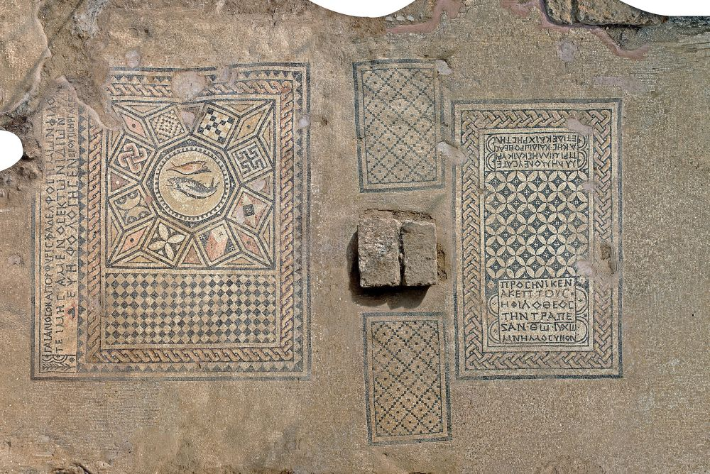
Communion at 230AD (Meggido Mosaic)
Remember Primilla and Cyriaca and Dorothea, and moreover also Chreste.
Gaianos, who is also called Porphyry, a centurion, our brother, having earnestly desired to do so, has commissioned this mosaic-inscription. Brutus has done the work.
Akeptous, the friend of God, has offered the table to God Jesus Christ (for) remembrance.
Notes:
Of note is that this is so far the earliest known “church building”
The red circle is where the table sits
You can see a fish symbol on the left which is an early Christian symbol
Commissioned by a Centurion, managed by women

Slide 20
Isaiah 55:8-9 ESV
For my thoughts are not your thoughts, neither are your ways my ways, declares the Lord. For as the heavens are higher than the earth, so are my ways higher than your ways and my thoughts than your thoughts.
Proverbs 3:5-6 ESV
Trust in the Lord with all your heart, and do not lean on your own understanding. In all your ways acknowledge him, and he will make straight your paths.

Slide 21



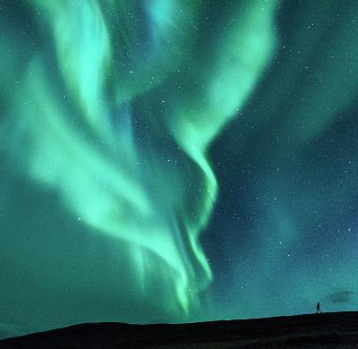
Summary
Passover and temple sacrifice pre-shadow the Lord’s supper aka communion
Understanding Passover and temple sacrifice enhances our understanding of the Lord’s Supper and why it is important

Slide 22
Epilogue
Matthew 5:8
"Blessed are the pure in heart,
for they shall see God.
Matthew 5:8
"Blessed are the pure in heart,
for they shall see God.
Notes:
Story
I know a guy who after being baptized into the church, fell away for some time. When he came back, he wondered how he could “walk” that “extra mile” to repent of all the sins he had committed in the past. He was grateful to God for answering all the requests of his prayers.
He thought to himself, what would be that extra mile besides praying and reading the bible?
He looked at how the early Christians had been breaking bread daily and thought that he would do the same.
Following this, understanding Matthew 5:23-24 (reconcile before offering) and 1 Cor 11:31-32 (judging ourselves rightly), he decided to think about his sins of the day to remain pure, making a decision each day to avoid or rectify the sins he had committed. After this, he would take the bread and wine at the end of each day.
To his surprise, on the day he decided to do communion daily, he started having dreams. He could not recall having dreams since his childhood, which would have been 30 odd years ago.
Ever since then, he had been anxiously and diligently doing communion, hoping for that dreams would follow. These dreams would carry messages of discipline and direction, as it is written in Psalm 23:1-4 ESV:
The LORD is my shepherd; I shall not want. He makes me lie down in green pastures. He leads me beside still waters. He restores my soul. He leads me in paths of righteousness for his name's sake. Even though I walk through the valley of the shadow of death, I will fear no evil, for you are with me; your rod and your staff, they comfort me.
If you know, the rod is used to drive sheep and it symbolizes discipline. The staff is often shown to give direction.
To this day, he has continued to do so. It is the hope that from this study that you, the audience, would also experience the wonderful relationship of discipline and direction.
James 4:8 Draw near to God, and he will draw near to you.

Slide 23

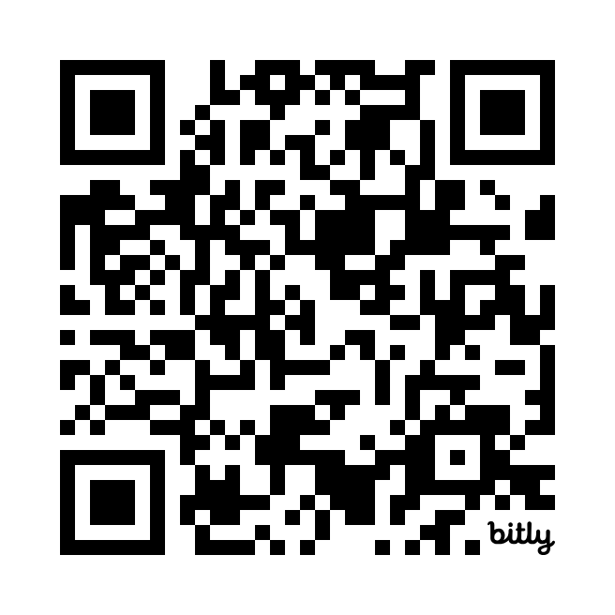
Thank You for listening
https://bit.ly/CommunionSlide
https://communion.findgod.help
Notes:
Feel free to save this

